Slide 1

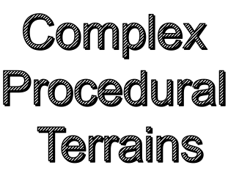
Zhimin Zhao
11/30/2015

Slide 2

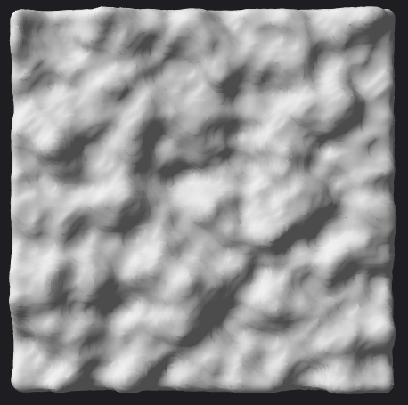
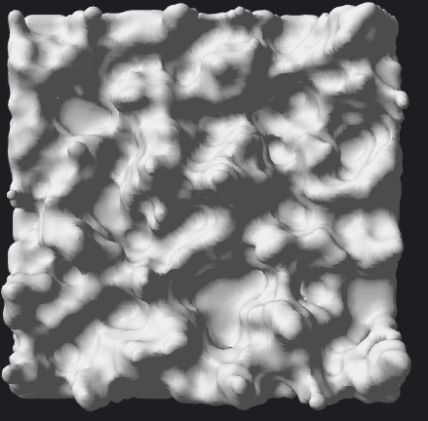

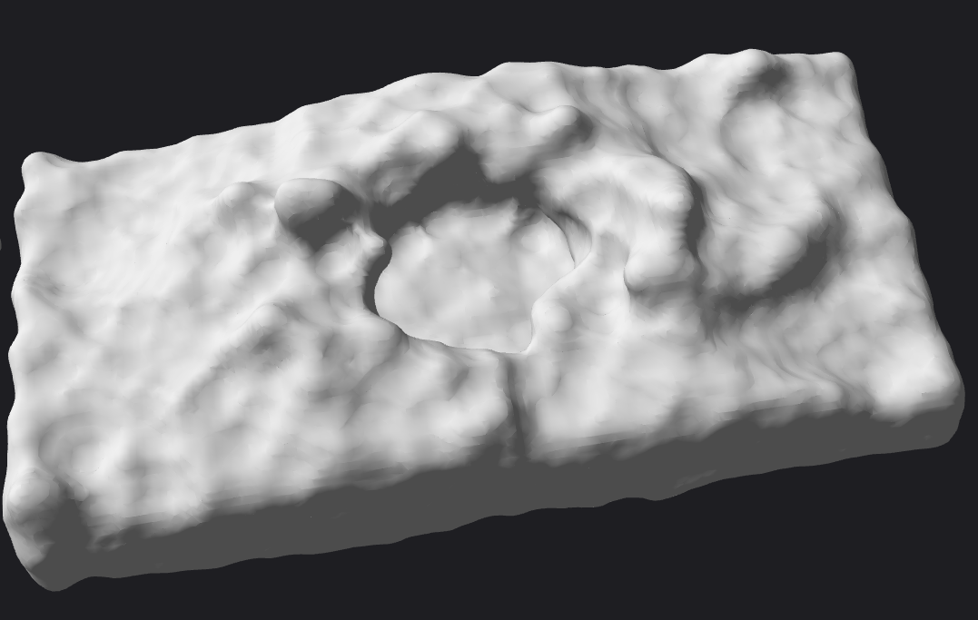
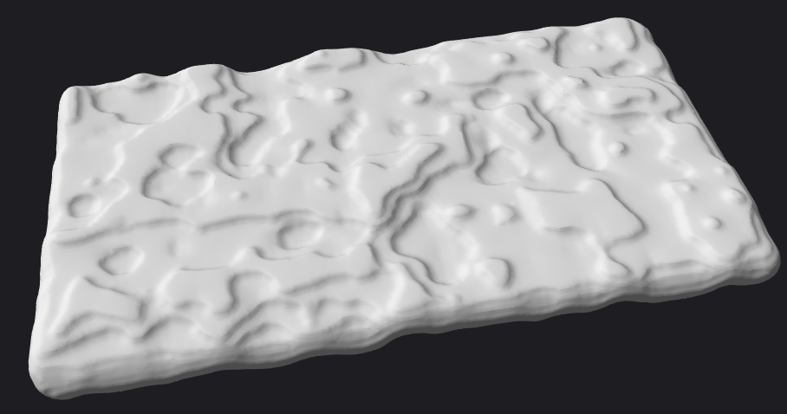
Milestone 3
Terrain Generation
Feature:
Plain
Upland
Mountains
Cavity
Terrace

Slide 3
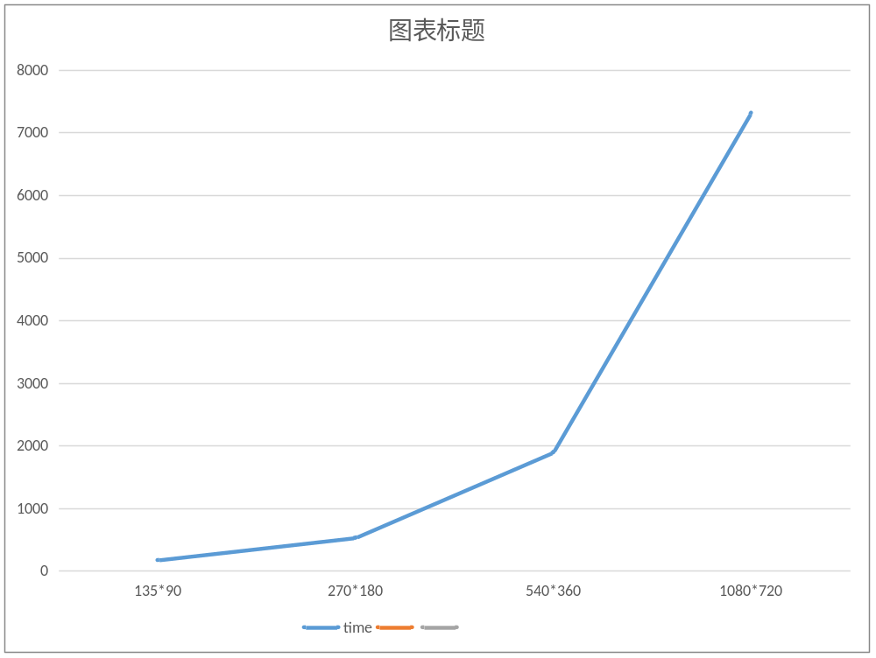
Performance Analysis
3

Slide 4
Next Step
3

Slide 5



